Slide 1

ASSIGNMENT - 2 ECON F215
Suvid Singhal
2023B3A70972P

Slide 2
History, Institutions, and Economic Performance
Abhijit Banerjee and Lakshmi Iyer

Slide 3
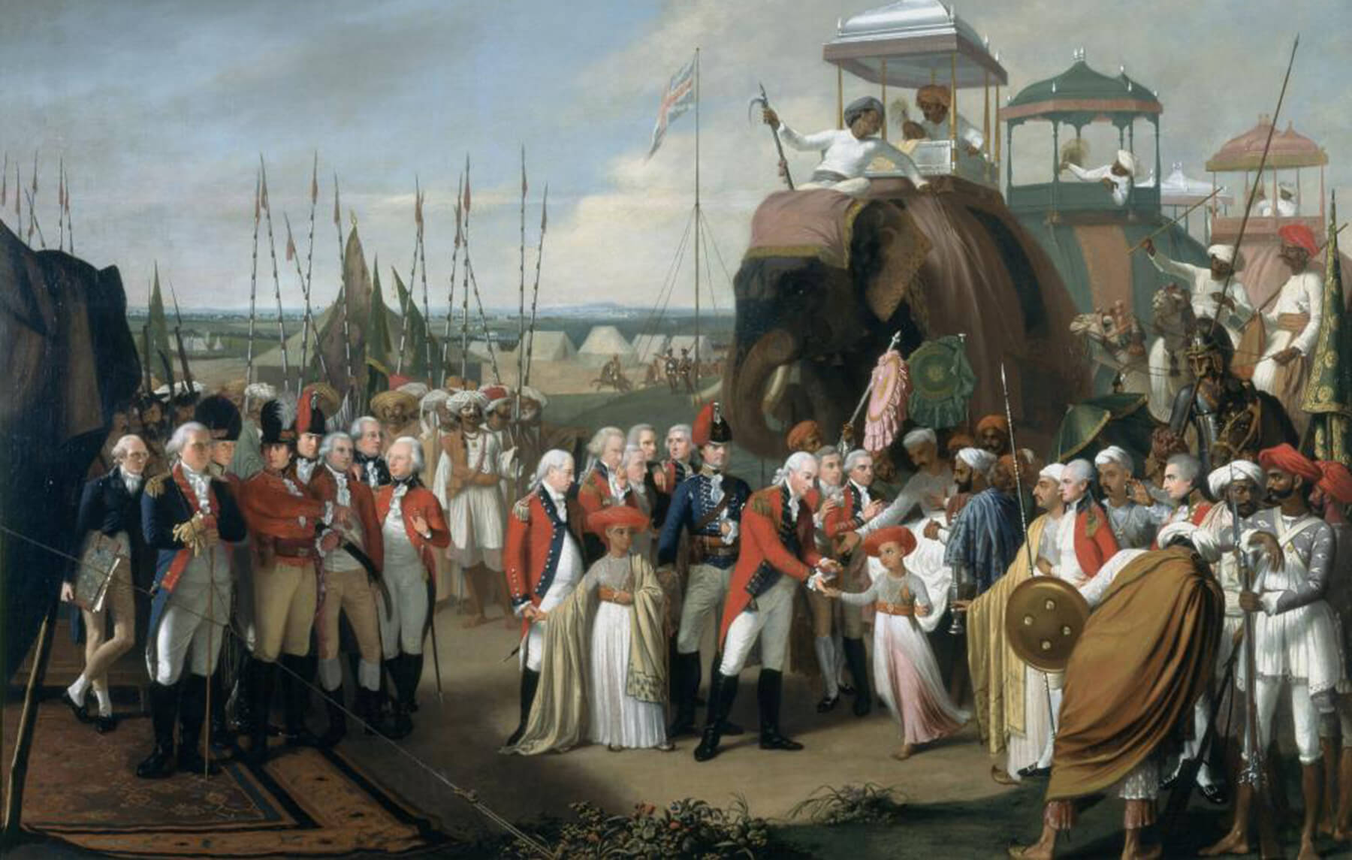
Research Question
How do historical colonial land tenure systems affect modern agricultural performance in India?
Focus: Landlord vs. Non-landlord systems
Goal: Replicate Table 4 results using R
We use OLS and IV Regression

Slide 4
Historical Background
Zamindari (Landlord-based): Rent collected via landlords; farmers lacked incentives
Ryotwari (Cultivator-based): Revenue collected directly from farmers; higher incentives
Mahalwari (Village-based): Revenue assessed collectively by village communities
Assignment of land systems was influenced by timing of British conquest, not land quality

Slide 5
Data and variables
Dataset: Banerjee & Iyer replication files (.dta format)
Dependent Variables:
Fertilizer use (kg/hectare)
Irrigation proportion
HYV (High-Yield Variety) adoption for rice, wheat, other cereals
Crop yields (log yields)
Key Independent Variables:
p_nland (proportion of non-landlord area)
Instrument: britdum (British conquest dummy 1820–1856, if that district was part of the British Empire from 1820-1856)
Controls: Rainfall, altitude, latitude, coastal dummy

Slide 6
Regression and causal inference
OLS Estimation: Outcomes were regressed on p_nland and geographic controls
Endogeneity Problem: Omitted variables, measurement error
Here, p_nland was correlated with error term
Instrumental Variable (IV) Strategy:
First Stage: p_nland ~ britdum + controls
Second Stage: Outcomes ~ predicted p_nland
Assumptions for Valid IV:
Relevance: Conquest timing must predict land system (Districts captured from 1820-1856 were mostly non-landlord ones)
Exclusion: Conquest timing affects outcomes only through land systems

Slide 7
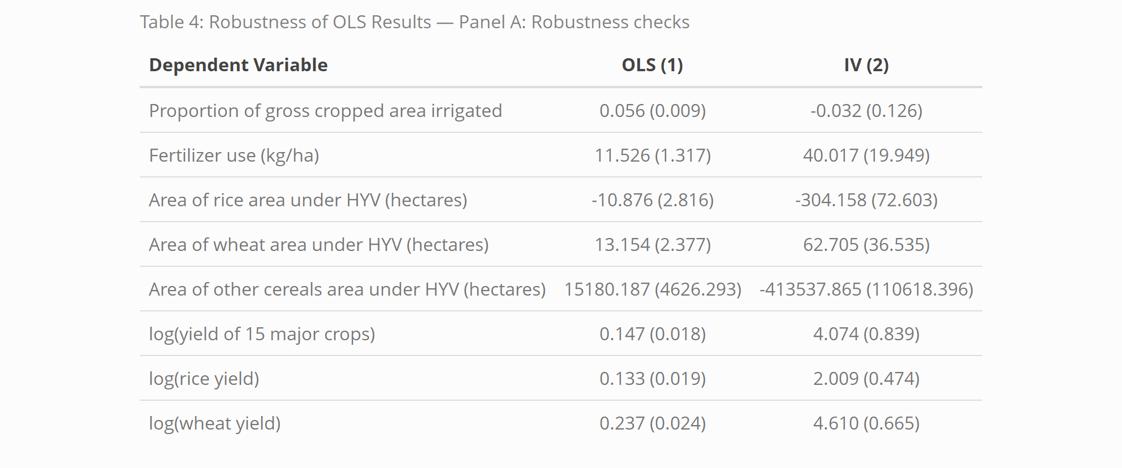

Slide 8
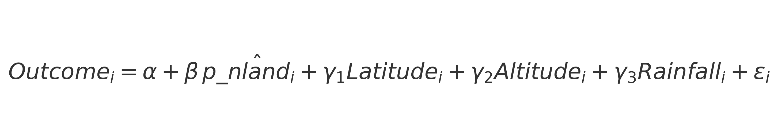
Table 4 — Panel A Results
Equation:
Fertilizer Use: Strongly positive causal impact under non-landlord systems
HYV Wheat Adoption: Higher in non-landlord districts
HYV Rice Adoption: Mixed results; possibly technology-specific
Crop Yields: Significantly higher (especially wheat yields)
Other Cereals: Area variable — large numerical coefficients due to hectares scale

Slide 9
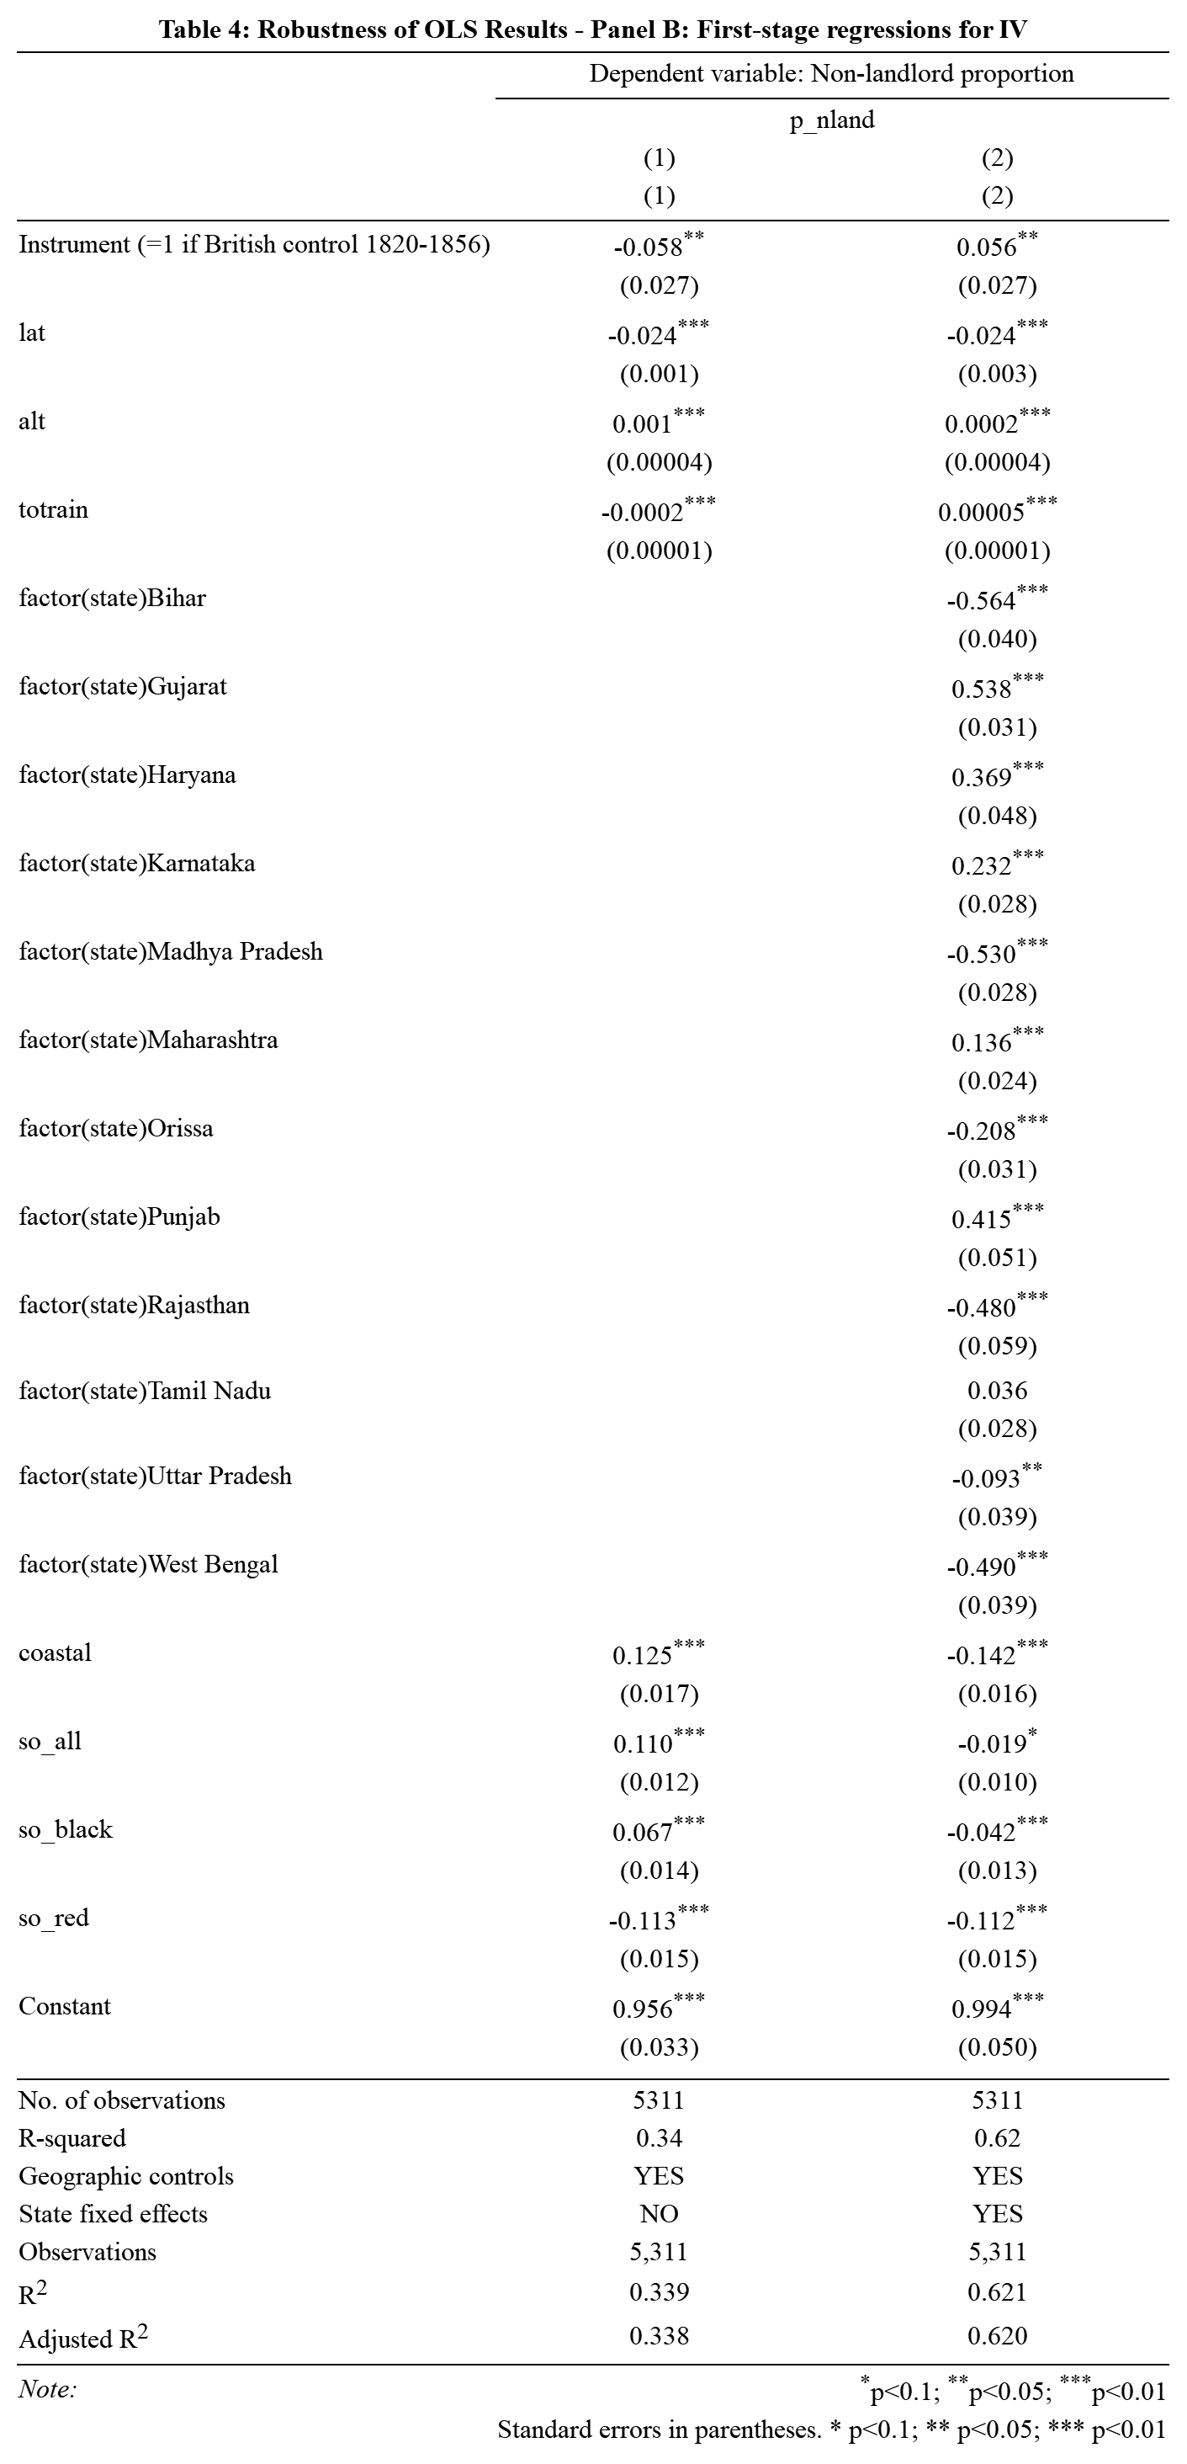

Slide 10
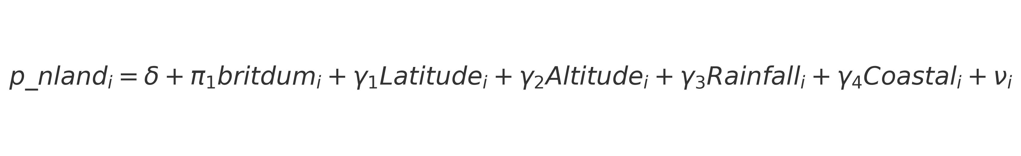
Table 4 — Panel B Results
Equation:
First Stage Regression Results:
britdum strongly predicts p_nland
First-stage F-statistics are high → No weak instrument problem
State Fixed Effects included in robustness checks
Instrument is strong and passes basic identification tests

Slide 11
An important observation
Without state fixed effects, the relationship between conquest timing and non-landlord share appears negative, likely due to confounding by differences across states. Some states may have had earlier conquests and landlord systems, others later and non-landlord systems.
When we include state fixed effects, we remove these cross-state biases.
The positive coefficient after controlling for state confirms that, within states, conquest between 1820 and 1856 led to a higher share of non-landlord systems, as expected based on the historical institutional change.
Some of the negative coefficients and difference in results for the instrument can also be largely attributed to these missing dependent variables in our version of the dataset:
Date of British land revenue control
Date of British land revenue control squared
These variables were for calculations in the original paper but missing from out dataset.

Slide 12
Addressing Identification Concerns
Selection Bias Concern: Land system choice based on conquest timing, not productivity
Conquest Timing Endogeneity: Driven by military and political resistance, not agricultural quality
Modern Policy Differences: Controlled using state fixed effects and geographic controls
Exclusion Restriction: No direct link between conquest timing and modern agricultural outcomes

Slide 13
Conclusion
Non-landlord systems encouraged greater agricultural investment and technology adoption
Higher productivity in areas with non landlord systems earlier
Persistence of Institutions:
Historical land systems have long-run economic effects even today
Replication results are consistent with the findings of Banerjee & Iyer (2005)

Slide 14
THANK YOU

